Slide 1
Enterprise Content Services

Slide 2
Topics
Service Overview
What is Enterprise Content Services?
Architecture & Infrastructure
Clients
Configuration
Security
Next Steps
OnBase Resources
Questions

Slide 3
Service Overview

Slide 4
Service Overview
Strategic Goals:
Implement a single, central Enterprise Content Services solution
Accommodate specific campus and departmental needs
Close integration with PeopleSoft enterprise applications
Funding Model: This system is funded through the campuses like other enterprise apps

Slide 5
Service Overview, cont.
Who is eligible to use the service: Administrative, Academic and Research groups are welcome to participate if they have a direct University affiliation
Staffing mix:
UIS Project Team
Distributed Project Team: Content Services Project Team
Vendor Consulting and Support Teams

Slide 6
What is Enterprise Content Services?

Slide 7
What is Enterprise Content Services?
A fully integrated Content Services solution which lowers costs, speeds access to the information your organization needs to be productive and minimizes your compliance and eDiscovery risks.
Maintain copies of your most critical business documents in a high-capacity, high-availability electronic document repository
Intelligently manage records throughout their entire lifecycle – from inception to destruction
Data can flow across the various organizations to promote efficient and consistent business processes

Slide 8
Core Functions
Capture
Manage
Access
Integrate
Measure
Store
Paper, Fax, Email & any other content
Automated data entry
OCR
E-Forms
Digital Signatures
Bulk imports
Workflows
Automated decisions
Manual reviews
Parallel Processing
Rules
Notifications
Tasks
Web client
Windows clients
Office Integration
Full Text Search
Portal
ICS
FIN
HCM
DocuSign
Reporting Dashboards
Workflow
Inventory
Exceptions
Productivity
Encrypted & secured
Records Management
Retention Management

Slide 9
Example Use Cases - Store
Permanent Record Cards (PRC):
PRCs contain all historical student class and grade information from the University’s founding until 1988
Admissions Processing:
Transcripts, applications, appeals, resumes and loose credentials
Financial Aid:
Tax data and verification data for applicants
Veteran's Affairs:
Selective Service and DD214 content
Advancement Office:
Gifts Processing
Anschutz Medical Campus, School of Medicine:
Faculty personnel files
School of Education and Human Development
Advising and Graduate program forms

Slide 10
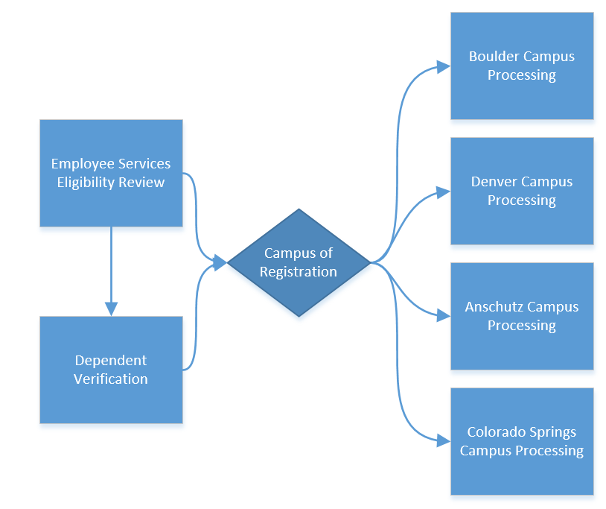
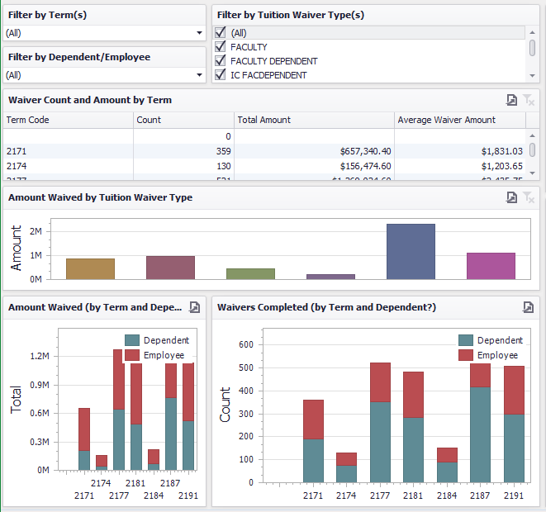
Example Use Case - Tuition Benefit Process
Capture: Content is created using an OnBase Unity Form.
Integrate: Employee and Student data from Campus Solutions ensures accuracy.
Manage: Approvals and processing performed in OnBase workflow.
Measure: Reporting Dashboards provide information.

Slide 11
Collaboration
Enterprise Content Services
Student
Finance
HCM
Application Processing
FOPPS
Employee Data
Student Data
Journal Entries
Security
Access requests
Advancement
Gift Processing
Research
Capital Equipment
Contracts
Benefits Processing
Research Content

Slide 12
Metrics
120 departments, 2900 users
Archive contains over 20 million documents
Over one million new pieces of content processed annually
Metrics Reporting Dashboard

Slide 13
Architecture & Infrastructure

Slide 14
OnBase Architecture
Web Client and Windows Clients
Web Client works with any browser
Fully scalable to meet the needs of the entire university community

Slide 15
OnBase Architecture, cont.
Four Environments: Production, Stage, Test and Development
Utilizing load balancing and redundancy
SAN for content storage
Oracle database for metadata

Slide 16
Infrastructure

Slide 17
ONBASE CLIENTS

Slide 18
Two Clients
Web Client
Unity Clients
Provides access to content through standard Web browsers
Supports SSO (SAML/PeopleSoft)
Windows Only
Familiar look-and-feel of Microsoft Office
No IT staff necessary, any end user can install these clients themselves using Microsoft’s ClickOnce technology
Updates installed automatically
Supports SSO

Slide 19
High-Level Client Functionality Comparison
Client | Web client | Unity client
End User Actions
Retrieve Content | X | X
Submit Content | X | X
Scan |  | X
Process Workflow | X | X
View Dashboards | X | X
Administrator Actions
Create Unity Forms |  | X
Create Dashboards |  | X
User Management | X | X

Slide 20
OnBase Clients - Web Client
Web Browser Compatibility
Browser | Version
Google Chrome | 64+
Microsoft Edge | EdgeHTML 16+
Mozilla Firefox | 59+
Mozilla Firefox ESR | 60+
Microsoft Internet Explorer | 11
Apple Safari | 10.1.x, 11.0.x, and 11.1.x

Slide 21
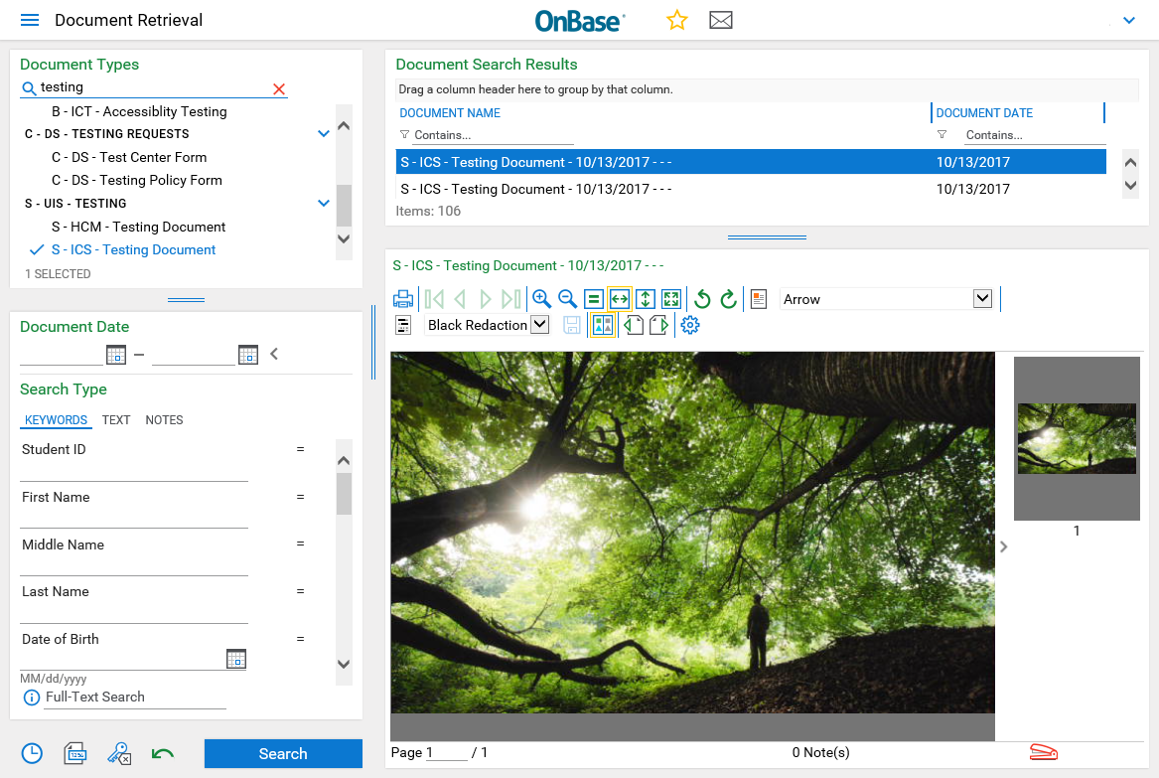
Clients - Web Client

Slide 22
OnBase Clients - Unity Clients
OnBase ClickOnce Clients
OnBase Unity Client (general/all purpose client)
Scan, Index, Process workflow, etc
OnBase Office Integration Clients (Office plug-ins)
Submit content right from your office application
Office 2016 (Outlook, Excel, Word) 32-bit Office only
With Windows 7 you must install Microsoft Visual Studio Tools for Office (VSTO) 10.0.50325 or higher
*Unity and Office Clickonce installer URLs must be invoked with either IE11 or Edge. Other browsers do not know how to handle Clickonce URLs.

Slide 23
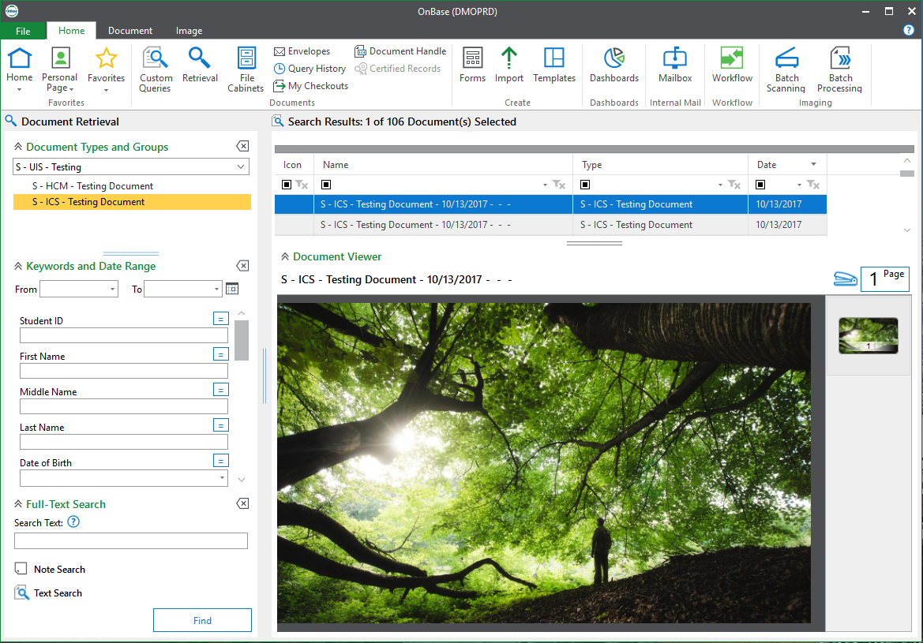
OnBase Clients - Unity Client

Slide 24
OnBase Office Integrations

Slide 25
ONBASE CONFIGURATION

Slide 26
OnBase Configuration
OnBase is designed to be extremely flexible and configurable for a customers' needs. There are six main areas that need to be configured for all new customers.
Document Types
Document Type Groups
Keyword Types
Keyword Type Groups
Users
User Groups

Slide 27
OnBase Naming Conventions
The naming convention in OnBase is designed to allow for all configuration elements of OnBase to be easily identified and managed both at the campus/department level as well as at the university-wide level.
Standard naming convention for all configuration in OnBase:
<Campus code> - <Department Code> - <Department-level naming>
Examples: D - HR - Personnel Records
B - ADM - Applications
C - AA - General Advising
S - ES - Overpayment Notice

Slide 28
OnBase Naming Conventions
Campus Codes:
A = Anschutz
B = Boulder
C = Colorado Springs
D = Denver
S = Systems
X = Not Campus Specific
T = Trust (not associated with any campus nor exclusively with the University, as they manage healthcare for CU, UPI, and UCH.)

Slide 29
OnBase Naming Conventions
Department Codes: (new department codes can be used when necessary)
AA = Academic Advising
ACCTG = Accounting
ADM = Admissions
AS = Arts and Sciences
AST = AS Support of Education Technology
BEN = Benefits
BUR = Bursar
CAD = Cross Area Documents
CEPS = Continuing Education
COE = College of Education
DS = Disability Services
ES = Employee Services
FA = Financial Aid
FAO = Faculty Affairs Office
FIN = Finance
GSS = Graduate Student Services
HON = Honor Code
HR = Human Recources
HWT = Health and Welfare Trust
INTLTX = International Tax
ISSS = International Student Services
JUD = Judicial Affairs
LAW = Law School
LeedsMBA = Leeds MBA Program
LeedsU = Leeds Undergrad Academic Advising
OOTP = Office of the President
PAF = School of Public Affairs
PCP = Pre-Collegiate Dev Program
PR = Payroll
PSY = Psychology
REG = Registrar
RIO = VC for Research
SDM = School of Dental Medicine
SEC = Security Documentation
SEHD = School of Ed and Human Dev
SOM = School of Medicine
SUEP = Special Undergrad Enrichment
UB = Upward Bound
VA = Veterans Affairs

Slide 30
OnBase Naming Conventions
Department Level Naming:
This part of the naming convention can vary depending on the business process, the function, the audience, and varies between departments but may require coordination across departments for similar or shared configuration.
i.e., Document type name, Document name, Disk group name, User Group name, Keyword name, Scan Queue name.
Examples:
Benefits Enrollments
Payline Adjustments
W-2
Dental Degree
Deposit Receipt
Pink Sheet
Transcripts
HSA Enrollment
Ops Verification

Slide 31
Document Types
Documents are organized into Document Types
Users will not have access to all Document Types, only the ones necessary for their role
Example Document Types:
A - DDS - Acceptance Letter
B - AS - Intent to Graduate Letter
C - ADM - Undergraduate Application
D - FA - Father W2

Slide 32
Document Type Groups
Each Document Type belongs to one Document Type Group, a group of similar document types, in a parent-child relationship.
Depending on how you organize your content, you’ll likely want 2-3 Document Type Groups (ex. Student, Employee, Research, etc.).
Users can search for documents by Document Type or Document Type Group.

Slide 33
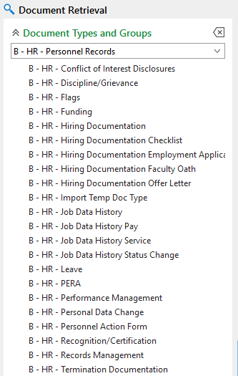
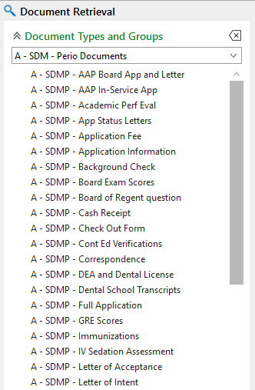
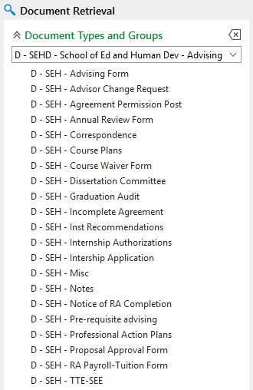
Document Type Groups
Document Type Group
Document Types

Slide 34
Keyword Types
Descriptions and values applied to document types
Why Create a Keyword Type? The 5 R’s
Keywords can be used along with full-text search!
Keyword Type | Keyword Value
First Name | Jane
Campus of Employment | Denver
Academic Year | 2019-2020
Retrieval
Reporting
Restriction
Relationship
Routing

Slide 35
Keyword Types
Data types: Alphanumeric, Numeric, Currency, Floating Point, Date, Date/Time, Data Set (predefined dropdown list)
Examples:
Student ID - Employee ID - First Name
Last Name - Date of Birth - Academic Career
Department - Serial No - Speedtype
Tax Year - Vendor Name - Check #

Slide 36
Keyword Type Groups
A Keyword Type Group is a set of Keyword Types assigned as a collection to a Document Type
Example:
Student ID
First Name
Middle Name
Last Name
Date of Birth
Campus Code
}
X - ICS - Basic Student Info

Slide 37
Keyword Type Groups
Example:
Employee ID
First Name
Middle Name
Last Name
Date of Birth
OperID
}
X - HCM - Basic Employee Info

Slide 38
Keyword Type Groups, cont.
Example:
Speedtype
Fund Code
ORG
Program Code
Project ID
Subclass
}
X - FIN - Accounting Services

Slide 39
Keyword Type Groups, cont.
Example:
Project ID
Project Name
Speedtype
State Appr Code
DocID
}
X - FIN - Capital Construction

Slide 40
Keyword Type Groups, cont.
Example:
Journal ID
Journal Date
OperID
Accounting Period
Fiscal Year
Source Code
}
X - FIN - Journal Entries

Slide 41
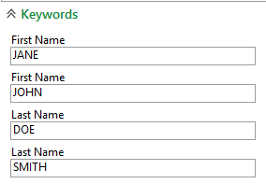
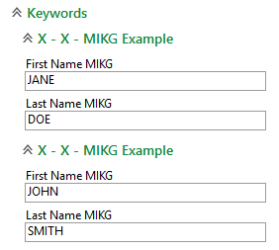
Multi-Instance Keyword Type Groups
Allows multiple keyword records to be created for the document.
Respects the relationship among values within each record.
Without Multi-Instance Group
With Multi-Instance Group
Document is for two people:
Jane Doe
John Smith

Slide 42
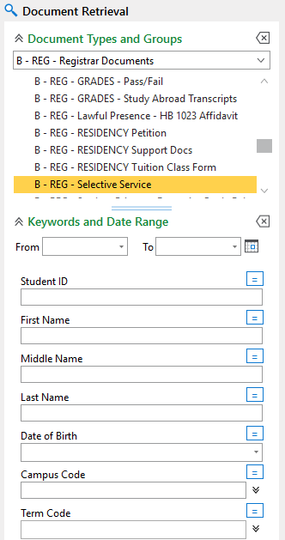
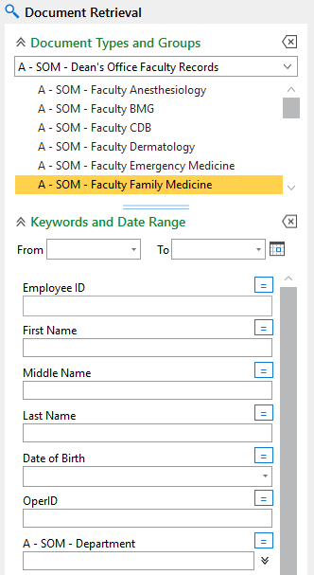
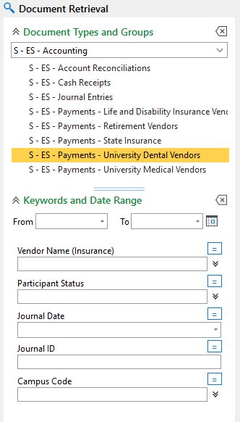
Document Types and Keywords

Slide 43
ONBASE SECURITY

Slide 44
OnBase Security Basics
Users are members of user groups which define their access.
Access is defined by two components:
What a user has access to, such as:
Document Types & Document Type Groups (including the content of those Document Types)
Scan Queues
Workflow Processes and Tasks
Reporting Dashboards
What the user can do with that content, such as:
View
Create
Modify
Print
Delete

Slide 45
OnBase Functional Security
All users must be in at least one “functional level” group to specify how they interact with all content they have access to:
Functional Lvl 1: View Only Users
View, no modify, no delete, no upload, no print
Functional Lvl 2: Standard Users
View, modify annotations only, no delete, upload, print
Functional Lvl 3: Power Users
View, modify, no delete, upload, print
Functional Lvl 4: Departmental Admin
View, modify, delete, upload, print

Slide 46
OnBase Functional Security
Other functional groups provide access to additional functionality as needed.
Add-On Functional Groups: Provide additional functionality to an individual user
Functional - Records Management
Functional - Document Delete
Functional - Workflow
Functional - DocuSign

Slide 47
OnBase Functional Security
Other functional groups provide access to additional functionality as needed.
Administrative Groups: Access to these requires training and certification
Functional - Admin - Document Retention
Functional - Admin - Records Management
Functional - Admin - System
Functional - Admin - Security - Users
Functional - Developer - Workflow
Functional - Developer - Unity Forms

Slide 48
OnBase Document Type Access
Granted using “User Groups”, each group may be granted access to one or more Document Types
Based upon Functions, Roles or Document collections for each organization
Examples:
User Group - B - AS - Dean's Files
User Group - B - HR - All Personnel Record Documents
User Group - C - BUR - Accounting
User Group - C - REG - Standard
User Group - D - BUR - 3rd Party
User Group - S - ES - Accounting

Slide 49
OnBase Document Type Access
Document Type Group 1
Document Type Group 2
Document Type 2.1
Document Type 2.2
Document Type 2.3
Document Type 1.1
Document Type 1.2
Document Type 1.3
Users in User Group A have access to all document types in Group 1 and two document types in Group 2.
Users in User Group B have access to one document type in Group 1 and all document types in Group 2.
A user in both groups will have access to all six document types.

Slide 50
Other OnBase Access
User groups are also used to grant access to the scan queues, workflow processing and other items as needed.
Examples:
Scan Queue - D - REG - Tuition Classification
Reporting - B - BUR - Student Accounts
Workflow - S - ES - Benefits Appeal

Slide 51
OnBase Security Example
User Security groups and Functional Security groups are layered to give users access and permissions
Example User: ABCD000123
Functional Level 2 - Standard Users
Functional Workflow
Scan Queue - C - ADM - All Scan Queues
User Group - C - ADM - Standard
User Group - X - ADM - Shared Documents
Workflow - C - ADM - Examiners

Slide 52
OnBase Next Steps
OnBase New Customer Packet
Scope of Expectations
Roles and Responsibilities
Go-live Checklist: Complete and Return
OnBase Template
Discuss internally about base configuration
Complete Document Type & Document Type Group Structure, with Keyword Types
Complete User & User Groups Mapping

Slide 53
OnBase Resources
Enterprise Content Services – OnBase
New Customer Information
OnBase Training Page
OnBase Technical Support
OnBase Certified Department Administrators
Enterprise Content Services Advisory Committee

Slide 54
Questions?

